Slide 1


Legislative-Executive
WorkFirst Poverty Reduction Oversight Task Force
August 21, 2025​ | 9:00 am – 12:00 pm
Notes:
1

Slide 2


Meeting Goals
  Understand the potential impacts of One Big Beautiful Bill Act (HR.1) on Washingtonians.
    Agency perspectives
    Community perspectives
  Discuss priorities and next steps given the changing federal and state landscape.
  Strengthen legislative-executive collaboration on state economic well-being goals.
Notes:
10

Slide 3


Mutual Expectations
  Maintain a respectful body language, tone, and volume when sharing our opinions​.
  Value the many different sources of knowledge; listen to the entire message without editorializing or interrupting​.
  Act in ways that edify collaboration​.
  Seek first to understand before being understood​.
  Be honest and explain why​.
  Always assume good intentions; give people the benefit of the doubt​.
  Look for places to agree, connect, and support – it helps us get to better solutions​.
  Make it a safe environment to share – no personal attacks​.
  Listen to the entire message, literally, and mentally:​
    Don’t interrupt – we are modeling respectful behavior; and​
    Our listening implies that we care, even if we don’t agree.

Slide 4


Housekeeping
TASK FORCE MEMBERS
PUBLIC ATTENDEES
  Panelists can participate in meeting; all other attendees are muted​
  Use your reaction/hand raise buttons to ask questions, speak and vote​
  Staff will count hands to determine outcome of votes
  Chat function is turned off​
  There are two public comment periods; when it is your turn to speak, you will be unmuted
  Use the Q & A If you have questions during the meeting
  Q&A should not be used for comments or discussion​
Notes:
3

Slide 5





Support Team
  ASL Interpreting
  Michael Arslanian & Seven Star from All Hands Community Interpreting Services.
  Economic Justice Alliance Team
  Lori Pfingst, PhD | Executive Director
  Livey Beha | Assistant Director, Aligned Initiatives & Operations
  Babs Roberts | Senior Advisor, Programs & Policy
  Gwen Teok | Senior Analyst, Research & Policy
  Lindsay Morgan Tracy | Director, Innovation & Outreach
Notes:
3

Slide 6

Opening Remarks
Rep. Mia Gregerson | 33rd Legislative District

Slide 7



Welcome new members!
  Senator Liz Lovelett
  40th Legislative District
  Daniel Zavala
  Department of Commerce
  Dan Zeitlin
  Employment Security Department
Notes:
10

Slide 8
Consent Agenda - Vote
  August 2025 Meeting Agenda
  November 2024 & May 2025 Meeting Minutes
  TANF Spending plan report
  Items for Information: WorkFirst Performance Measures | DSHS
Notes:
10

Slide 9


Advisory Council Co-Chair Update
  Johnathan Hemphill
  Expert with Lived Experience
  Amy Martinez
  CEO, South Central Workforce

Slide 10
Public Comment
Listening
If you would like to comment, please use the “raise hand” feature or send an email to LEWPRO@dshs.wa.gov, which is also posted in the chat.

Slide 11
Impacts of HR.1 - One Big Beautiful Bill Act
Panel Discussion
[Alliance Advisory Council Member]
Lori Pfingst | Executive Director, DSHS, WA Economic Justice Alliance
Carla Reyes | Assistant Secretary, DSHS, Economic Services Administration
Jason McGill | Assistant Director, Health Care Authority, MPD
Shirley Prasad | Director, Washington Health Benefit Exchange, Government Affairs
Sarah Peterson | Director, DSHS, ESA, Office of Refugee and Immigrant Assistance
Jennifer Dellinger | Policy Associate, State Board for Community and Technical Colleges, Student Services

Slide 12





3 Million Washingtonians will be affected by changes to SNAP, Medicaid & Marketplace
FAMILIES
IMMIGRANTS
& REFUGEES
RURAL RESIDENTS
PEOPLE WITH DISABILITIES
AGES 54-64
The vast majority of families receiving TANF, Working Connections Child Care, and Apple Health also receive SNAP.
New work requirements for families with children 14 and older will make accessing SNAP and Medicaid benefits harder for families.
The vast majority of families receiving TANF, Working Connections Child Care, and Apple Health also receive SNAP.
New work requirements for families with children 14 and older will make accessing SNAP and Medicaid benefits harder for families.
Immigrants who do not meet the new qualifying-alien definitions are cut off from federal SNAP and Medicaid benefits and marketplace tax credits.
State-funded programs serving immigrants that do not meet new qualifying-alien definitions are at risk of reduction due to lower federal share rates.
Rural counties have higher rates of SNAP and Medicaid assistance and tax credit benefits compared to urban counties. The loss will compromise rural household budgets and local economies.
The agricultural community will lose revenue due to SNAP cuts.
People designated as Able-Bodied Adults without Dependents (ABAWDS) in counties with limited job opportunities and seasonal workforce are no longer exempt from work requirements.
The majority of people receiving assistance through the Aged, Blind or Disabled, SSI and vocational rehabilitation programs, as well as people with development disabilities also receive SNAP.
New work requirements will make accessing SNAP and Medicaid benefits harder for people age 54-64.

Slide 13
HR.1 Undermines State Progress on Reducing Poverty
Summary of HR.1 Impacts on Strategies in 10-Year Plan to Dismantle Poverty
 | 10-Year Plan Strategy | Summary of Impact
1 | Undo Racism & Inequality | Disproportionally hurts Indigenous, Black, Brown and rural white communities, immigrants and people with disabilities who already carry a disproportionate burden of poverty. Makes the federal and state tax system more regressive for low income, working- and middle-class families.
2 | Balance Power & Resources | Concentrates income gains to the wealthiest households, exacerbating income inequality. Destabilizes state budgets and increases competition for investment in essential public goods. Increased immigration enforcement and reduced public assistance exacerbates economic exclusion.
3 | Increase Economic Opportunity | Reduces net resources for at least 3 million Washingtonians receiving public assistance annually, making it harder for individuals and families to afford basic needs, like food and rent. Reduces financial assistance for higher education, limiting mobility pathways and educational attainment. Imposes penalties, restrictions, increased demand on and reduced access to education, training, and supports that make it possible for workers to train and for local businesses to grow.
4 | Ensure Foundational Health & Well-Being | Estimates suggest 137,000 are at risk of losing food assistance. Estimates suggest between 200,000-320,000 are at risk of losing health insurance. Destabilizes the food assistance and health care ecosystems. Cost of medical care and out-of-pocket medical expenses likely to increase for all.
5 | Prioritize Urgent Needs | Anticipated increase in poverty will trigger downstream increases in hunger, homelessness, child neglect and behavioral illness.
6 | Build a Holistic Continuum of Care | Makes safety net more fragmented and cumbersome to navigate. Complicates progress to modernize health and human services technology platform.
7 | Decriminalize Poverty | Reduces the rights of immigrants who do not meet the new qualifying-alien definitions, including their access to safety net, education and employment resources.
8 | Prepare for the Future of Work | Weakens the ability of health and human services, education, and workforce development to train workers and help them adapt to an economy rapidly changing due to AI and automation.

Slide 14
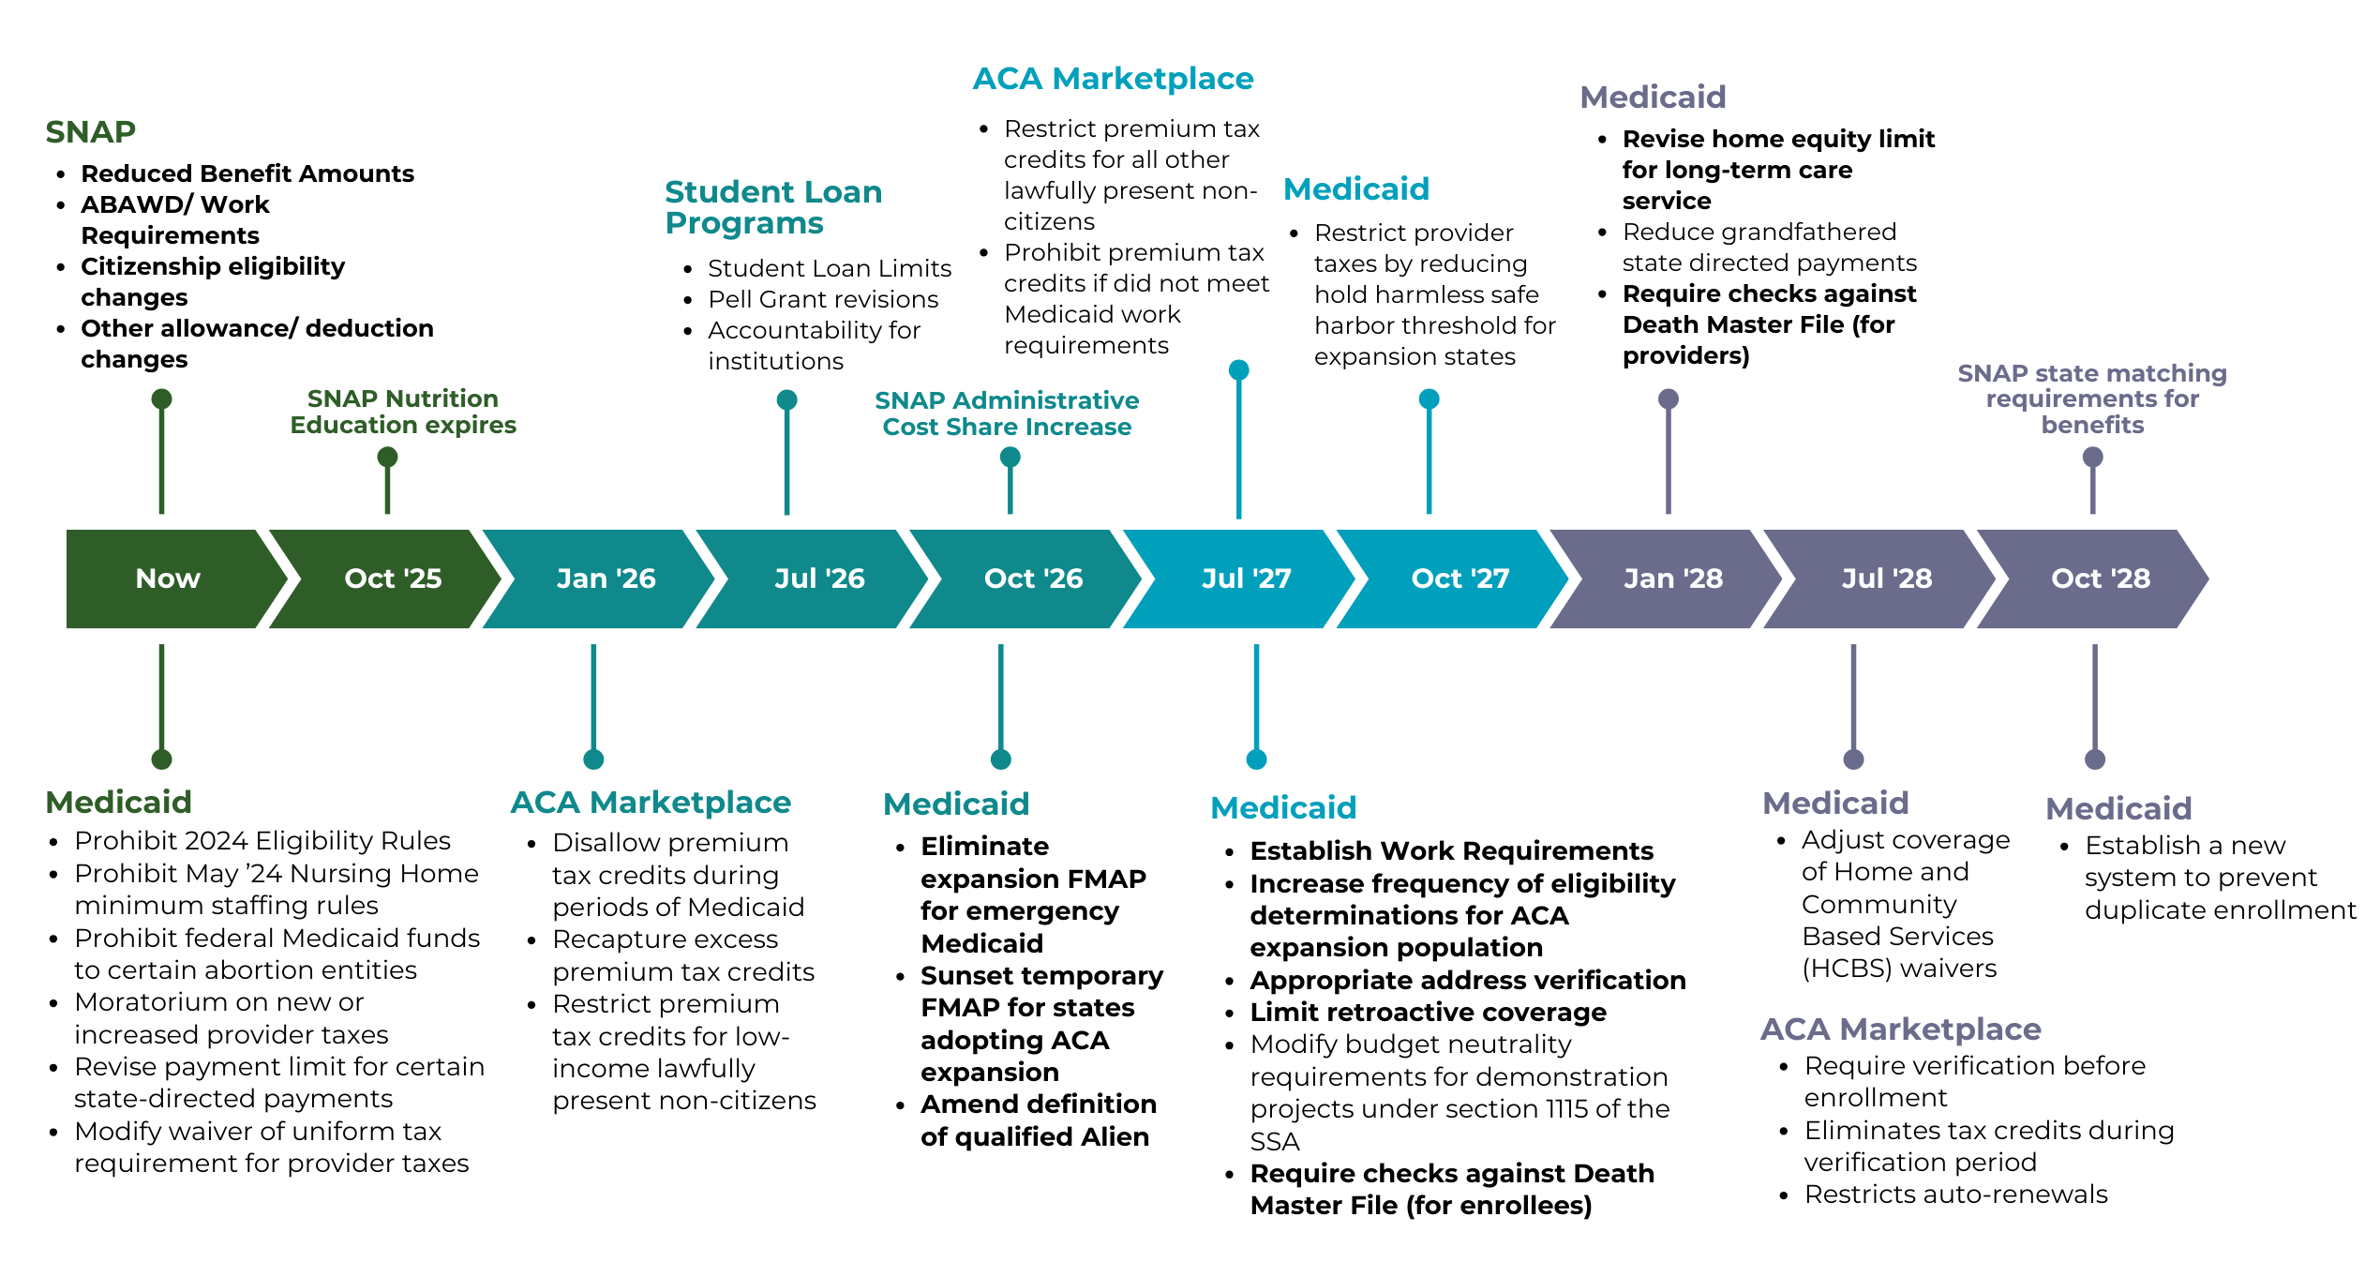
HR.1 Timeline
Notes:
What is down the road?
President’s budget proposal is under consideration now and suggests sweeping changes to workforce funding and education
Washington State is continuing to watch its own revenue forecasts and its impact on current budget deficits
WRAP UP talking points:
Reiterate compounding and downstream impacts
Bracing for additional changes (appropriations bill)

Slide 15




Food Assistance Impacts (SNAP)
920,000
35%
are children
people received assistance purchasing
food through SNAP
32%
are adults who are elderly or disabled
11.5%
of the population in Washington
20%
are working adults
Impact of Changes
$162 million
33,000
137,000
increase in annual additional cost to state budget
would lose benefits if they fail to meet new work requirements
lawful permanent residents would be excluded from SNAP
Monthly loss in benefits for households

Slide 16

SNAP Major Changes
Limits SNAP eligibility to legal citizens, lawful permanent residents, and certain, and narrowly defined groups of legal immigrants from Cuba/Haiti/Compact of Free Association nations
Increases work requirements and reduces work exemptions
Increases state costs for benefit and program
administration​
Limited ability to confer a standard utility allowance based on LIHEAP participation
Reduces SNAP benefits across Washington
Defunds SNAP Education

Slide 17




Medicaid Impacts
1,950,000
47%
of children in WA
people received health care through Apple Health (2024)
4%
of adults who are elderly or disabled in WA
25%
of the population in Washington
18%
of adults in WA
Impact of Changes
$42 billion
200,000-320,000
42%
reduction in Medicaid expenditures over the next 10 years
people are projected to lose Medicaid coverage due to changes to eligibility rules
decrease in funding to hospitals through lower State Directed Payments

Slide 18

Medicaid Major Changes
Restricts payment for protected health services
Changes funding for non-citizens
Imposes work requirements as a Medicaid eligibility requirement
Increases the frequency of eligibility redeterminations
Shortens retroactive coverage period
Restricts new state directed payments (SDPs) from exceeding Medicare payment levels
Requires cost-sharing
Changes requirements for address verification
Removes good-faith waivers related to erroneous payments

Slide 19

ACA Marketplace Customer Impacts
(WA Health Benefit Exchange)
Triple federal threats facing WA Exchange customers
HR.1 + 2025 CMS Marketplace and Program Integrity Rule + Expiration of Enhanced Premium Tax Credits
Premium increases of up to 15%
Ripple effect across the health care system, including $100M+ in uncompensated hospital care
Enrollment loss of up to 140,000 customers

Slide 20

Health Benefit Exchange Customer Impact
HR 1
Restrict premium tax credits for lawfully-present, non-citizen customers
Eliminate premium tax credits for Medicaid termination due to work requirements
Requires pre-enrollment verifications
2025 CMS Marketplace & Program Integrity Rule
Shorten open enrollment period to 9 weeks
DACA recipients not eligible for premium tax credits
Reduce failure to reconcile timeline (in HR.1 also)
Expiration of enhanced premium tax credits
Key driver in record enrollment for the last 2 years
Anticipate net premium increase of 65%
Anticipate 80,000 customers drop coverage because of unaffordability

Slide 21

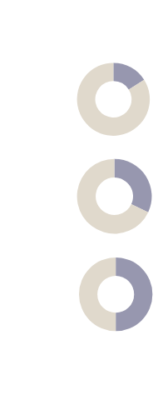
Impact on Immigrants
1, 222,300
Immigrants in Washington
$22.9 billion
Immigrant tax contributions annually
16%
of population
20%
of labor force
50%
of agricultural sector
Impact of Changes
Many immigrants and refugees will lose or see reduced benefits to programs such as SNAP, Medicaid, health care premium tax credits, and the Child Tax Credit
New and increased fees will create new financial barriers for immigrant workers and those seeking humanitarian parole to obtain status, stability, and safety
Increased immigration enforcement will lead to family separations and loss of family income through detention and removal
$27,900
Increased scrutiny
on immigrants and refugees may discourage access to programs they are eligible for
Average annual loss in federal and state tax revenue per one loss of immigrant worker

Slide 22

Student Aid Changes & Impacts
  Pell Grant eligibility narrowed
  Loan and grant options reduced
  Loan relief options restricted
  New Program: Workforce Pell for short-term, job-aligned certificates
  Reduction of loan and grant options for post-secondary students.
  Increase student cost burden, impacting students’ ability to fund post-secondary education.

Slide 23

Downstream Impact on Post-Secondary System
Increased food insecurity and economic pressures on post-secondary students may impact ability to succeed.
Increased demand on education & training programs due to work requirements may overwhelm available capacity.

Slide 24

Impact on the Economy
$6.5 billion
$52 million
17.4%
14,000
Energy, construction and manufacturing jobs lost due to clean energy divestment
loss to WA state GDP by 2030
Potential state and local tax revenue loss
Loss in federal funding for SNAP and Medicaid in 2029
12,100
400
14,100
Health care jobs lost due to Medicaid funding loss
Direct food and agriculture jobs lost due to SNAP funding loss
Other jobs lost due to SNAP and Medicaid funding losses
Notes:
OTHER FACTORS
ECONOMIC IMPACT (livey’s infographic)?

Slide 25
Ideas for Strategic Direction
Discussion
Continue to align strategies with north star goals that center well-being of people and places.
Leverage AI and technology to streamline eligibility and enrollment across programs to reduce error rates and administrative burden.
Leverage public-private partnerships to strengthen safety net ecosystem and coordination of state and local resources.
Develop a 1-, 3- and 5-year strategy to weather current conditions and prepare for opportunities that may arise in the 2027-29 biennium.
What priorities are top of mind for you as we begin implementation on HR 1?
How can we leverage the collaboration in this task force to implement HR 1?
What do you think of these ideas for how we strategically move forward? What other ideas do you have?

Slide 26
Strengthening Legislative-Executive Collaboration
Requests

Slide 27
LEWPRO Trailer Bill
  Clarify Intent - new intent section
  Change the name - suggestions
  Membership and voting changes
  Update duties to reflect recent alignment decisions
  Updates Advisory Council to reflect changes

Slide 28
Public Comment
Listening
If you would like to comment, please use the “raise hand” feature or send an email to LEWPRO@dshs.wa.gov, which is also posted in the chat.

Slide 29
Good of the Order
Meeting Adjourned

Slide 30


Thank you.
Notes:
23

Slide 31
Sources
American Council on Education. (2025, July). One Big Beautiful Bill Act (H.R.1). https://www.acenet.edu/Documents/Summary-One-Big-Beautiful-Bill-Act.pdf
American Immigration Council. (2025, July). Immigrants in America 2023. https://map.americanimmigrationcouncil.org/locations/washington/
American Immigration Council. (2025, July). What’s in the Big Beautiful Bill? Immigration and Border Security Unpacked. https://www.americanimmigrationcouncil.org/fact-sheet/big-beautiful-bill-immigration-border-security/
Bureau of Economic Analysis. (2025, June). State GDP. https://www.bea.gov/sites/default/files/2025-06/stgdppi1q25.pdf
Bureau of Labor Statistics. (n.d.). Economy at a Glance - Washington. https://www.bls.gov/eag/eag.wa.htm#eag_wa.f.p
Economic Services Administration, Department of Social and Health Services. (2025, July). Analysis of the One Big Beautiful Bill Act.
E2. (2024, September). Clean Jobs America 2024. https://cleanjobsamerica.e2.org/wp-content/uploads/2024/09/E2-2024-Clean-Jobs-America-Report_September-17-2024.pdf
Economic Services Administration, Department of Social and Health Services. (2025, January). ESA Briefing Book State Fiscal Year 2024.
Energy Innovation LLC. (2025, July). Economic impacts of the “One Big Beautiful Bill Act” energy provisions in Washington. https://energyinnovation.org/wp-content/uploads/OBBBA-impacts-on-Washington.pdf
Health Care Authority. (2025, March). Medicaid in Washington [PowerPoint slides].
Ku, L., et al. (2025, June). How Medicaid and SNAP cutbacks in the “One Big Beautiful Bill” would trigger big and bigger job losses across states. https://doi.org/10.26099/tryd-ht51
Manatt Health (2025, July). Senate-Passed H.R. 1: Updated estimates on impact to state Medicaid coverage and expenditures, hospital expenditures, including impacts by congressional district.
National Immigration Law Center. (2025, July). The anti-immigrant policies in Trump’s final “Big Beautiful Bill,” explained. https://www.nilc.org/resources/the-anti-immigrant-policies-in-trumps-final-big-beautiful-bill-explained/
National Renewable Energy Laboratory. (2025, August 5). Household energy and transportation burden, state and local planning for energy. https://maps.nrel.gov/slope
Commission for Hispanic Affairs. (2025, July). This Week in Immigration: The ‘Big Beautiful Bill’ Is Ugly for Tax-Paying Immigrants.
U.S. Congress. (2025, July). One Big Beautiful Bill Act, 119th Congress (2025-2026) (H.R.1). https://www.congress.gov/bill/119th-congress/house-bill/1
Washington Health Benefit Exchange. (2025, July). Analysis of One Big Beautiful Bill Act.
Washington State Board for Community and Technical Colleges. (2025, July). Analysis of One Big Beautiful Bill Act.

